Slide 1
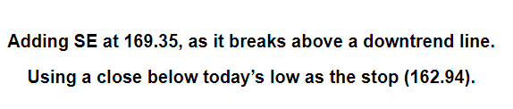
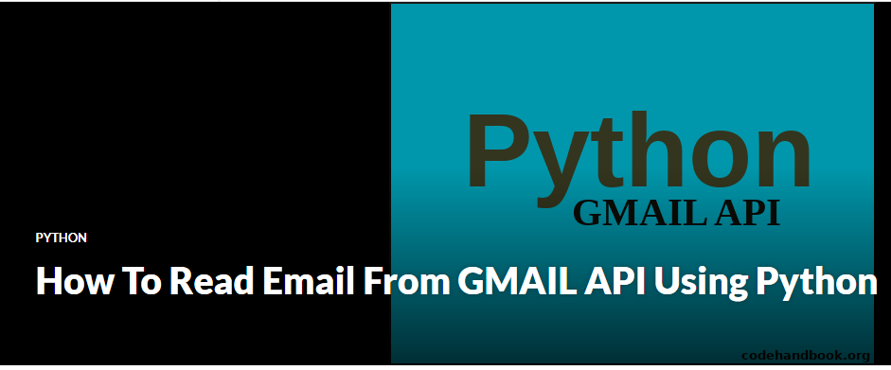
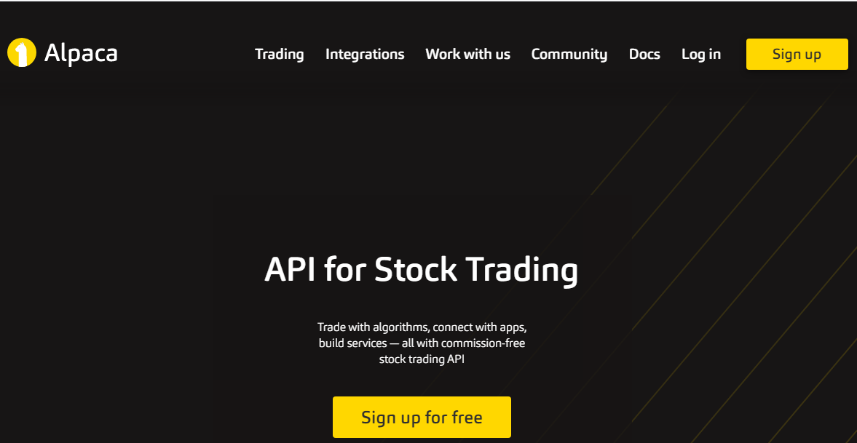
Brief Description
Outline of the project
Gmail information
Buy or Sell Information in a gmail
A python program to read the information form gmail
A python program to execute buy and sell automatically in Alpaca API trading

Slide 2
Scope
I subscribe stock screening services
They screen large amount of stocks and identify suitable stocks. The send an email message with buy price, sell price and stop loss price. I subscribe to 3 different stock screening services.
I manually enter the buy or sell
The moment I receive the email, I log in to my trading account and buy stocks at the current market price and with suggested stop loss price. This is takes time and manual input .
What am I looking for
I want to automate this process

Slide 3
Requirements
Find a developer who has previous similar experience on this job
Develop the program
Test the automation
Start a paper trading account in alpaca or similar trading platform
Measurable 1: Precision
Data set: 3 buys and 3 sells of two screening subscriptions each
Action item:
The program buys with in 0.5% of the suggested price.
The program buys and sells in the order it is received
The program does not buy if the price of one stock is greater than $500
The program creates an order only for current market price
The program creates a stop loss order that is good till cancel
The program should sell if an later email notification to sell 1/3 or 2/3 of holding
The program uses only below $5000 for each buy.
Criteria: Must buy and sell 3 stocks each in the same sequence as received
Measurable 2: Time
Data set: 3 buys and 3 sells of two screening subscriptions
Action item: Measure the time taken for each trade execution
Criteria: The program buys or sells quicker than manual trade.
Measurable 3: Errors
What if: a symbol does not match?
What if: a stock was sold manually before email notification?
Measurable 4: Manual stop and start
Must have an option to manual stop and star
Implement automation
System requirements
Internet speed requirements
Email requirements
Service
Add on
Mobile control
Manual stop
Error notifications

